Slide 1
TextSpot AI
Orientador: Sérgio Aleixo
Alexandre Gazur - 102751
Daniel Ferreira - 102885
João Matos – 103182
Ricardo Pinto - 103078

Slide 2
Goals
Allow users to detect synthetic text through a browser extension;
Calculate metrics (ex. perplexity) for identifying synthetic text;
Allow the use of different models and metrics for synthetic text detection and be easily extensible, allowing you to add new models or metrics;
Work on content in web pages and PDF files;
Highlight the excerpts according to the “probability” of corresponding to synthetic text, allowing the user to define the level from which the highlighting is applied.

Slide 3
01
State of the art

Slide 4



Related Work
Originality.AI
GPTZero
OpenAI
Dap
Plagiarism Checker and AI Detector
Plagiarism Scores
Highlighted Portions
File Batch Uploads
Classifier trained to distinguish between
AI-written and
human-written text.

Slide 5
02
Actors & Use Cases

Slide 6

Actors
Regular User
Admin
LM Developer
Journalists, Researchers, Social Media Users, Teachers, Students, etc.
Initial our team of 4.
Have maximum/all permissions.
Anyone with a LM can easily add their own language models and metrics to be used by our AI.

Slide 7
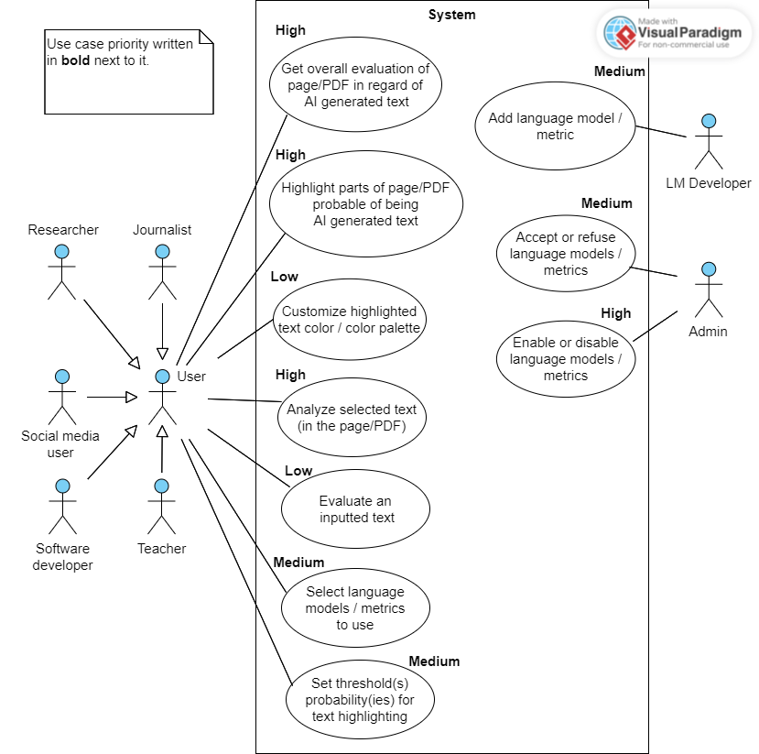
Use cases

Slide 8
03
Requirements

Slide 9
Functional Requirements
Extension downloadable via the web and work in at least 1 browser;
Overall analysis of the current web page or PDF file;
Highlight suspicious parts of the current web page or PDF file;
Flexible architecture and AI;
Customizable by the user through an intuitive UI:
Turn on/off;
Set threshold(s) probability(ies) for text highlighting;
Select which language models and metrics to use;

Slide 10
Non Functional Requirements
Performance: Efficient and fast even with large text;
Reliability: Quality AI and Language Models:
Compatibility: At least Chrome;
Usability: Intuitive UI;
Flexibility: Addiction/ Removal of Language Models and metrics;
Security: Respect and assert quality of user's data;
Maintenance: Clean code, good documentation.

Slide 11
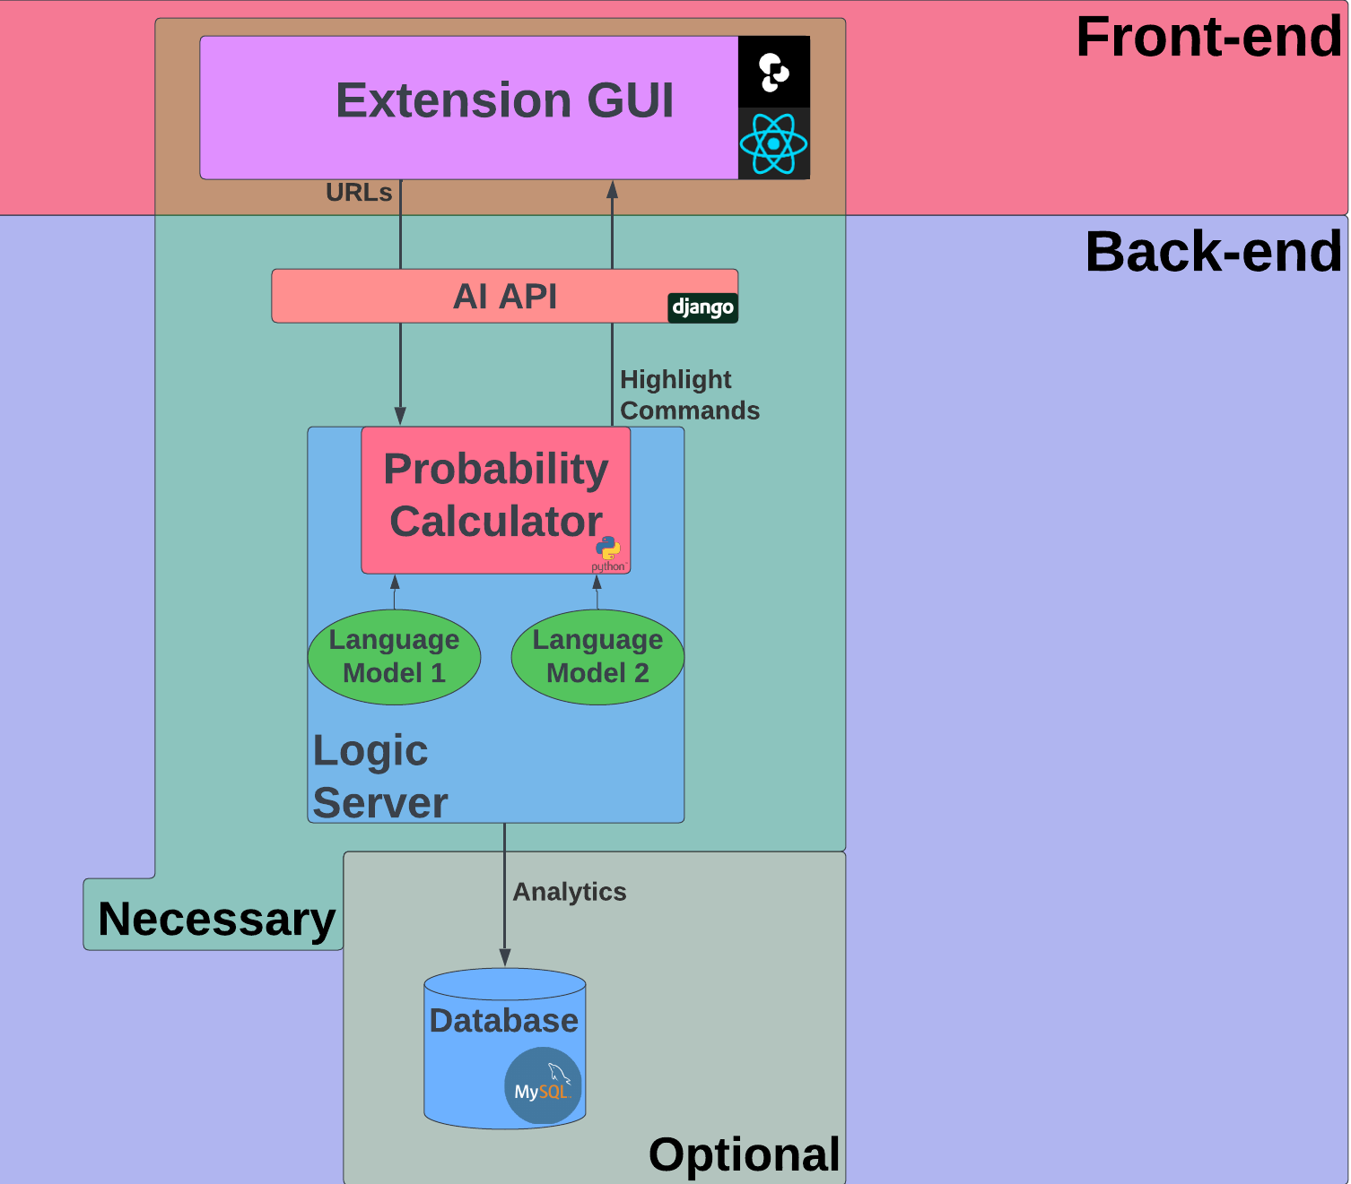
04
Architecture

Slide 12
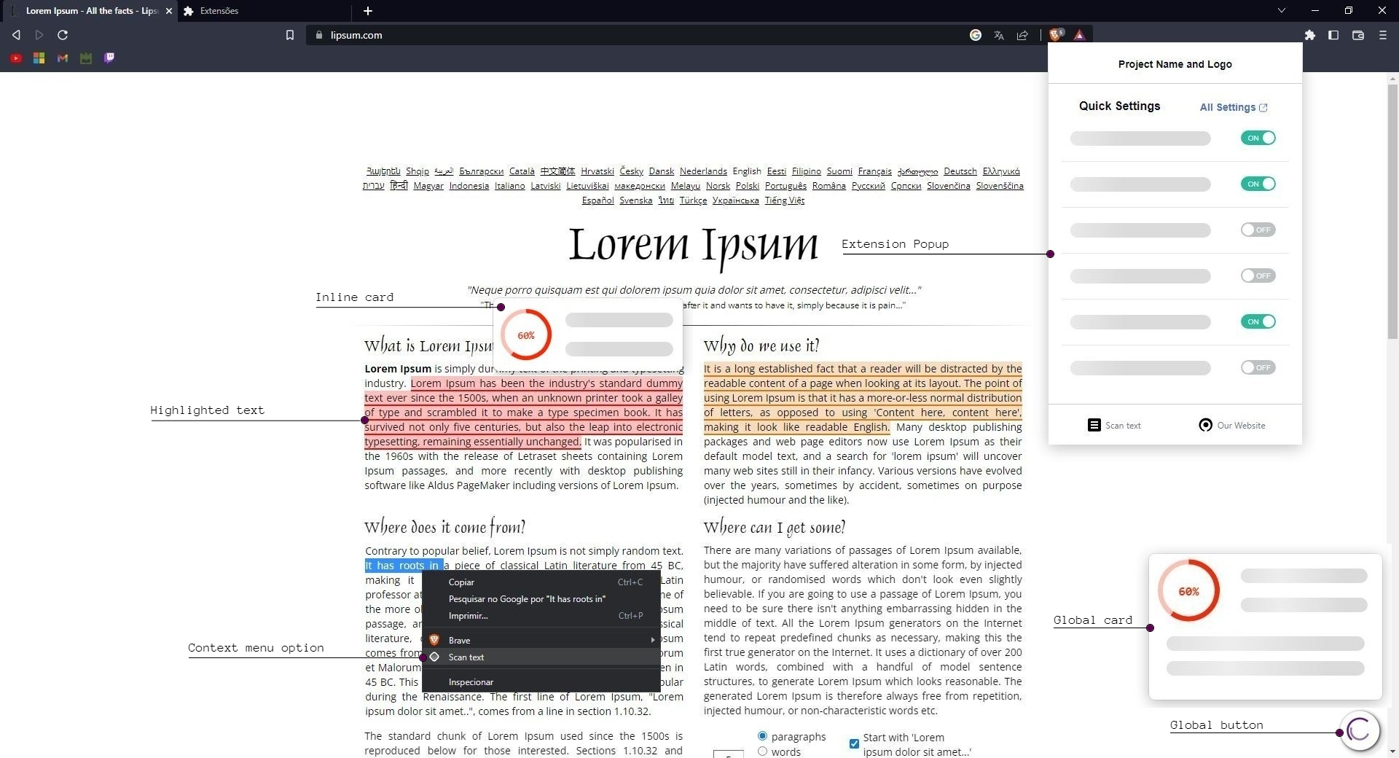
Mockup

Slide 13
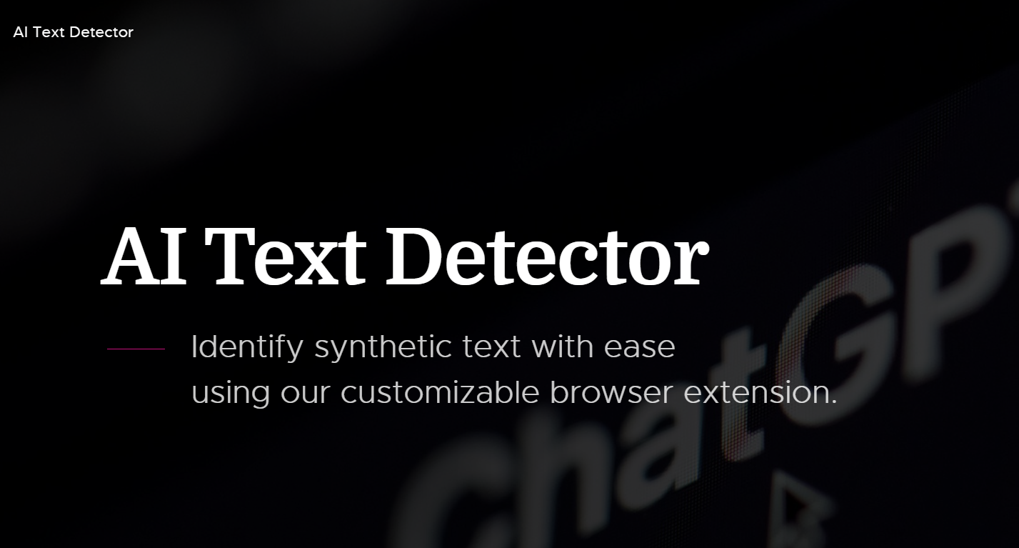
Project Website

